Slide 1
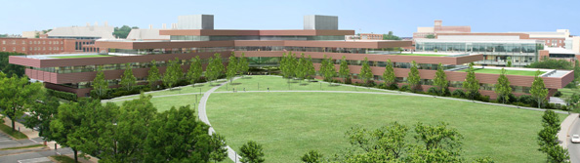

The Millennium Science Complex
Thomas Villacampa
Alexander Stough
Christopher Russell
Stephen Pfund

Slide 2
Presentation Overview
Interpretation of Deliverable
Presentation Components
  BIMception approach
  Façade Redesign
  Plenum Coordinatinon
  Semester Look Ahead

Slide 3
BIMception Approach
Integrated approach from the beginning
Goal is to make the building more cost-effective and energy efficient
Discussion of areas where improvements can be made
Discussions led to focus on façade and plenum space
These locations offer opportunities for everyone to get involved, and provide benefit to the building and its owner

Slide 4
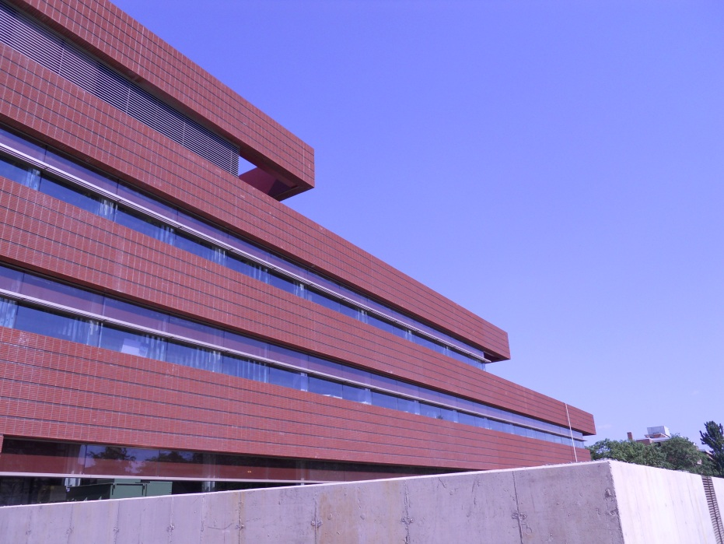
Façade Redesign
The façade offers opportunities for everyone to get involved.
Integrated approach to see how we can have an effect on the façade, and what these changes would affect for each of us

Slide 5
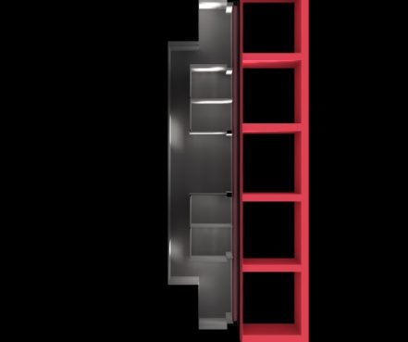
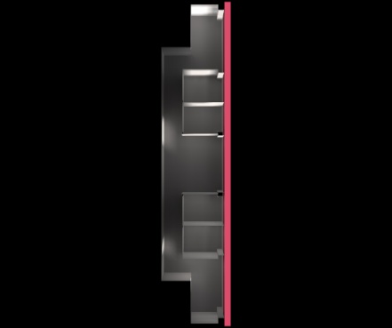
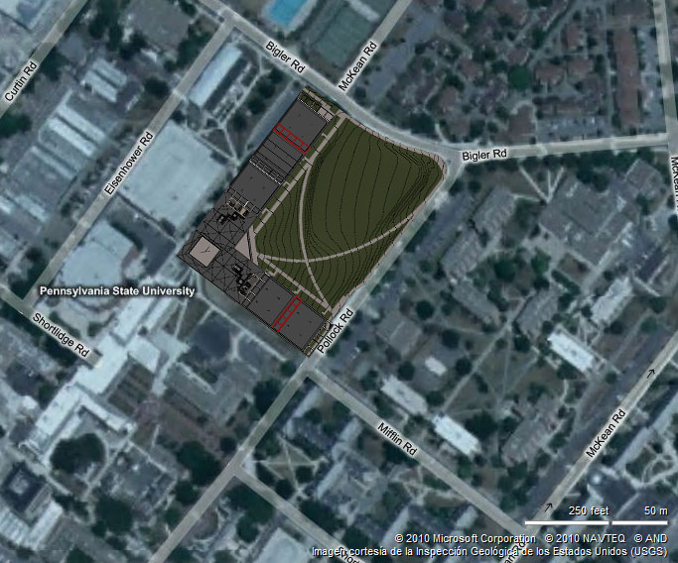
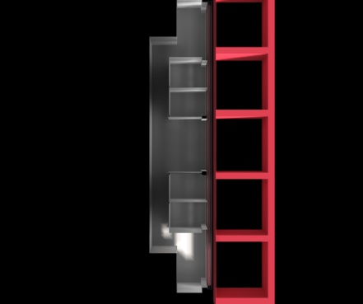
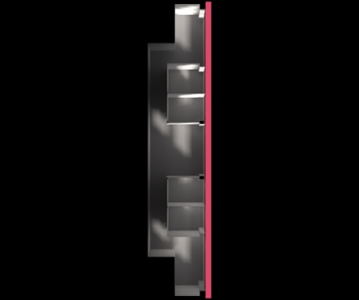
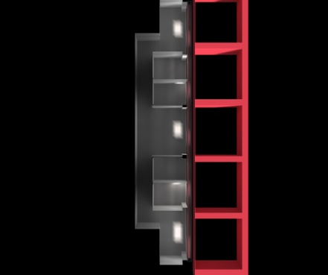
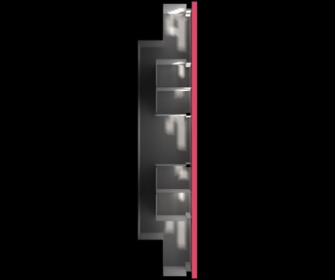
EXISTING Overhang study
  Bigler Road Summer Morning

Slide 6
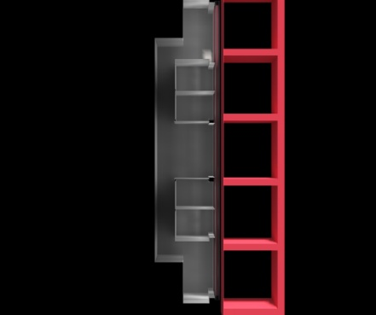
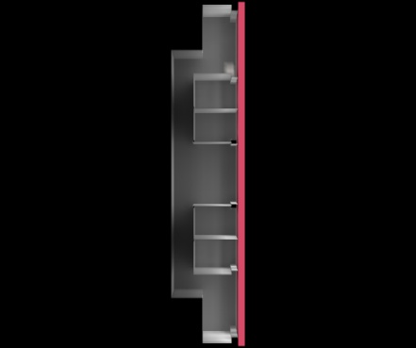
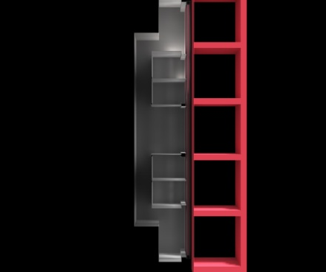
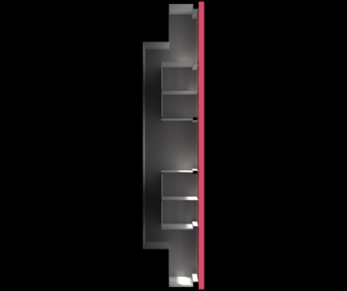
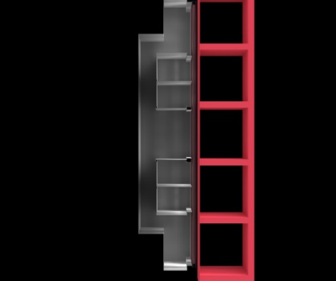
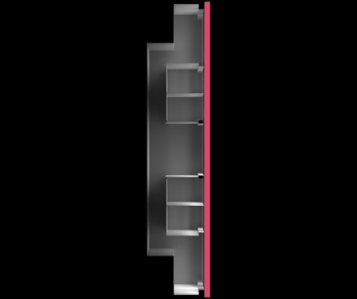
EXISTING Overhang study
  Pollock Road Winter Evening

Slide 7
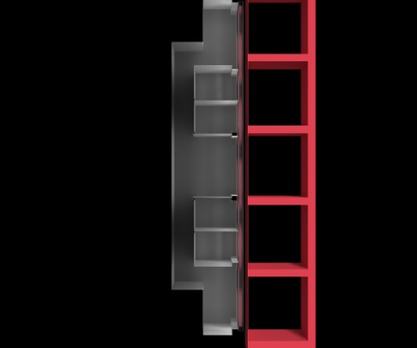
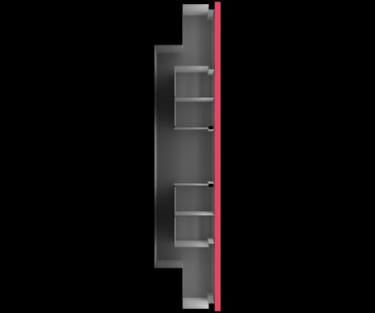
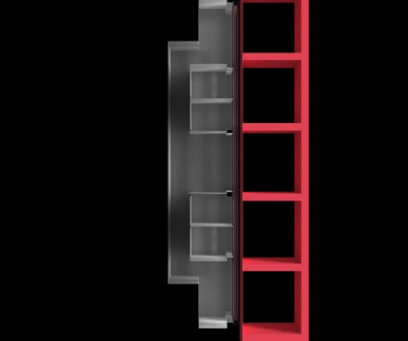
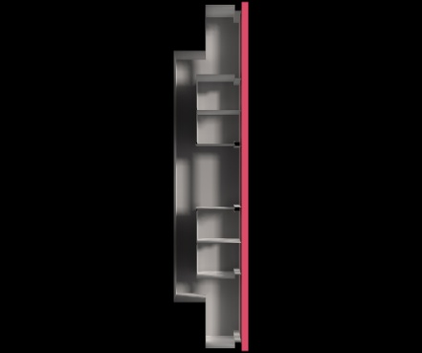
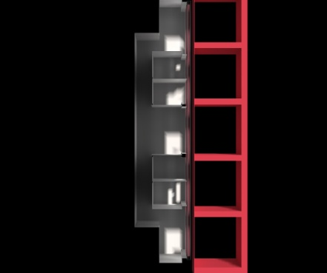
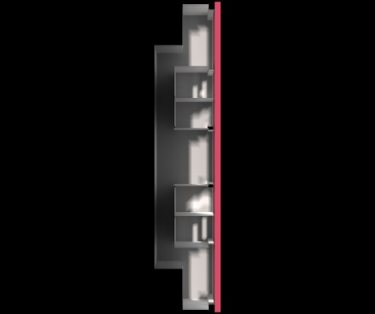
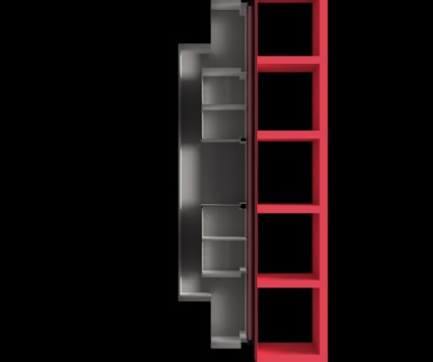
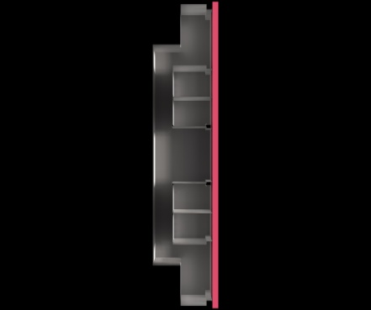
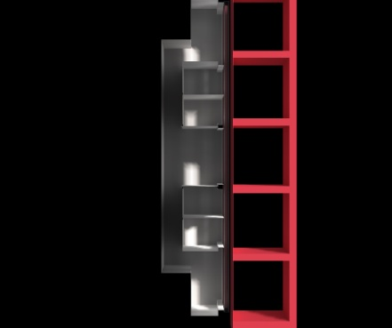
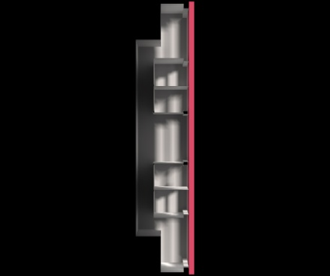
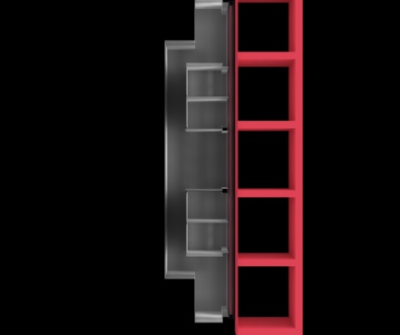
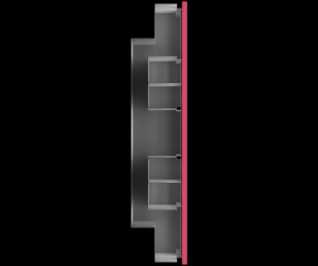
EXISTING Overhang study
  Pollock Road Summer Evening

Slide 8
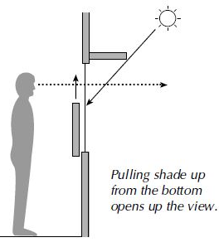
Façade- daylighting
  Option 1 – Existing with new shades
  Glazing properties
  Bottom up shades
  Shade properties
  Positives
  View
  Keeps Architects theme
  Coordination
  Mechanical Engineer to select appropriate material properties
  Negatives
  Not optimized
  Doesn’t address façade specific considerations

Slide 9
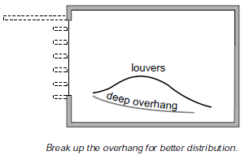
Façade- daylighting
  Option 2 – Altering Light shelf
  Façade specific?
  Glazing properties
  Shade properties
  Position of light shelf
  One large one VS multiple smaller ones
  Extend within the space.
  Positives
  Optimize the system
  Keeps Architects theme?
  Coordination
  Mechanical Engineer to select appropriate material properties
  Structural Engineer to for supporting the shelves
  Construction Manager to see schedule changes and cost associated with a façade specific decision

Slide 10
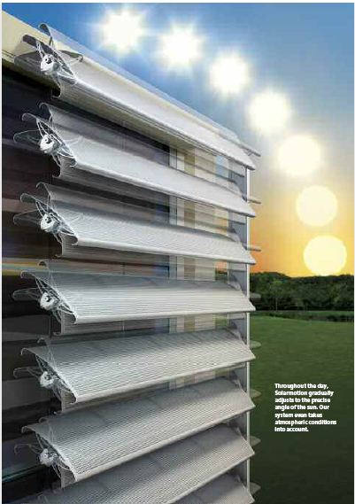
Façade- daylighting
  Option 3 – Solarmotion
  Solar tracking automated shades
  Located within the existing glazing setback
  Positives
  Keeps Architects theme
  Optimization
  Coordination
  Mechanical Engineer to select appropriate glazing
  Structural Engineer to for supporting the shade
  Construction Manager to see schedule changes and cost associated with an automated system
  Negatives
  Expensive
  Lose views

Slide 11
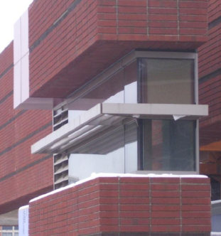
Daylighting and Solar Load
Envelope load is integral to solar load
Glass is a poor insulator
Balance wall to glass ratio for best daylighting and energy performance

Slide 12
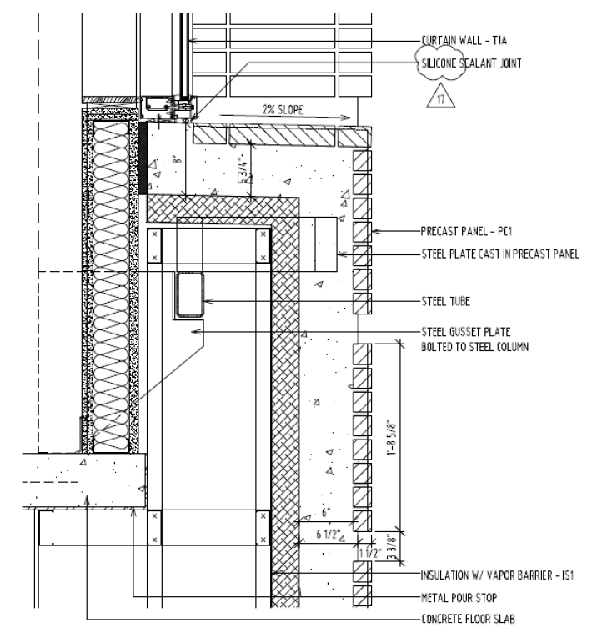
Façade Composition
2” Brick
6” Concrete
4” Insulation
12” Airspace
Incorporate Phase Change Materials or Water Thermal Storage
Reduce Envelope Loads

Slide 13
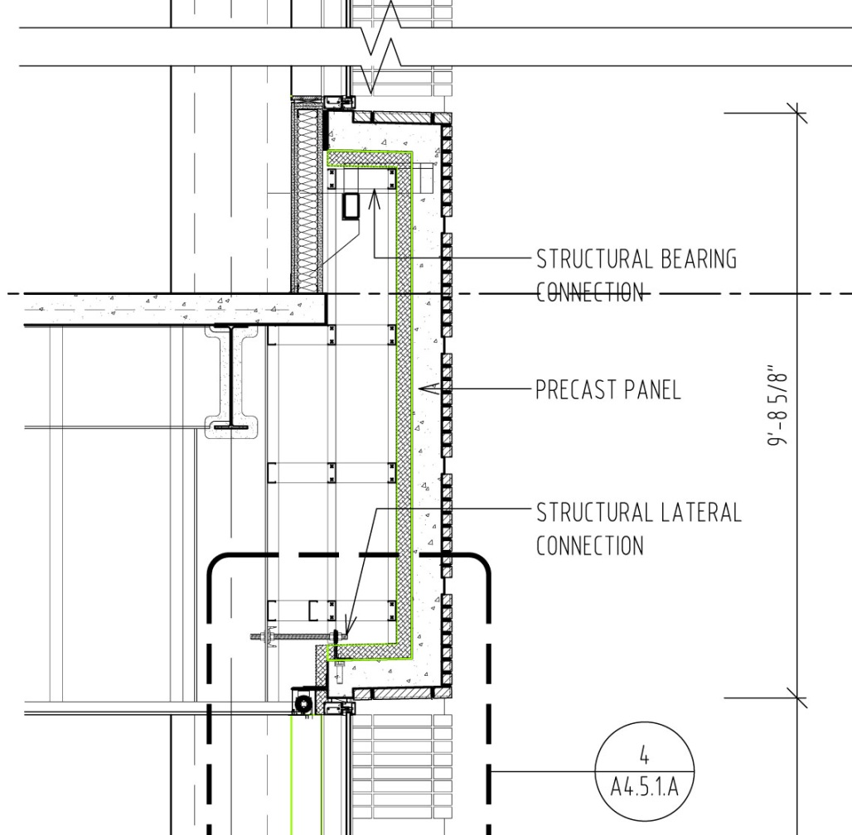
Façade- Structural
Weight is main concern.
  Current Precast Panels- 25,000lb
  1/10 Building Weight
  6-8” Concrete with insulation backing
Weight Reduction
  Less concrete
  Introduction of lighter phase change materials and insulation
  Direct relation to gravity and Seismic Loads
    Linked to size of columns and lateral resisting elements
  Reduced connection requirements.

Slide 14
Construction of the Façade
Changes to the façade clearly have a ripple effect through all disciplines
Each change will have cost and schedule implications associated with them
According to the schedule, the entire enclosure will be completed in January 2011, and will have a total construction duration of 303 days
Cost of enclosure is approximately $16.5 million

Slide 15
Construction of the Façade
Lightweight façade can lead to smaller structural load
  Reduced connection requirements will lead to lower cost
Change to materials of precast panels will have direct effect on cooling and heating loads in building
  Any change to mechanical systems due to these changing loads will directly impact the cost of the building
  However, if the redesigned panels lead to a more efficient system, the savings found in lifecycle costs could outweigh any potential increase in upfront cost

Slide 16
Construction of the Façade
Adjustments to daylighting systems
  Any additions to the current will have a corresponding cost, but as with the mechanical systems, more efficient systems will lead to savings over the lifetime of the building
While redesigns to the interior systems will produce effects on the construction of the building, placing mechanical shades on the exterior of the building will be a greater concern from a construction standpoint
  Increased crane time
  Sequencing of construction with enclosure

Slide 17
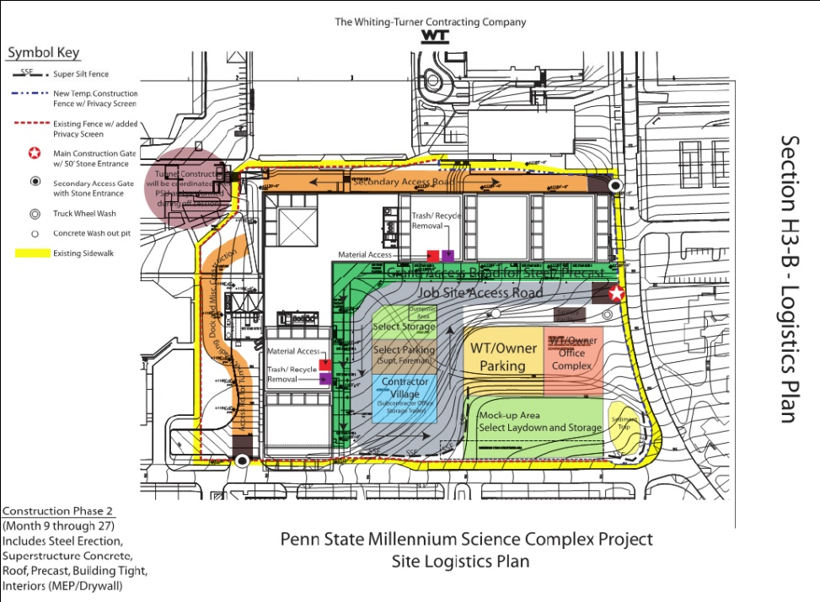
Construction of the Façade

Slide 18
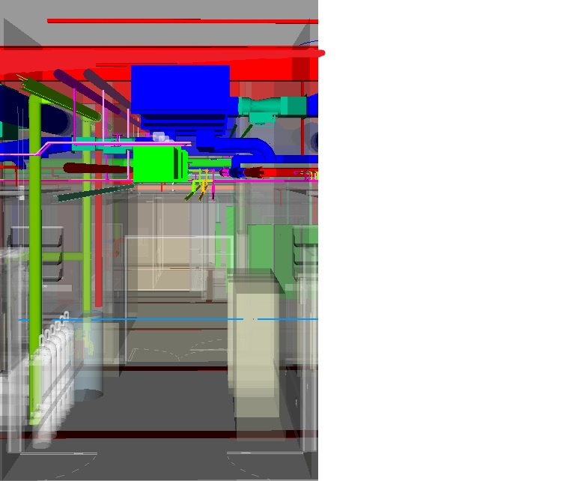
Ceiling Plenum Integration
  Requires coordination of all disciplines
  Space is at a premium
  The vertical dimension has universal cost impacts.
  A redesign could better manage design decisions to enhance the costs and performances of each system

Slide 19
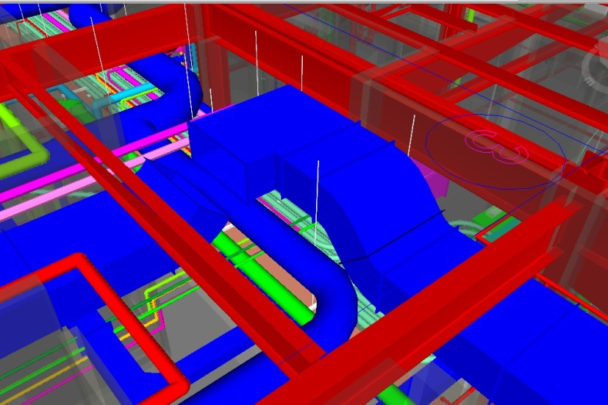
Static Pressure Losses From Compromised Duct Layout
  Static pressure losses = wasteful energy losses
    Fitting Losses
    Friction Losses
    10% Pressure Reduction = 15% Fan Energy Reduction
  Increasing Plenum Height
    Decreases Collisions
    Increase Duct Sizes

Slide 20
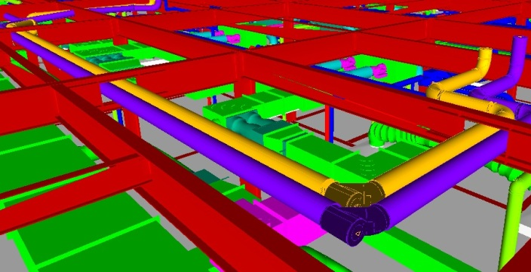
Efficient = Effective?
  Compromises and Conflicts
    Efficient Structure- Over 2ft vertical profile
    BIM models show field conflicts
      High levels of congestion
      Slab and beam penetrations
  Reevaluation of floor system can address conflicts
    Reduction and/or ellimination

Slide 21
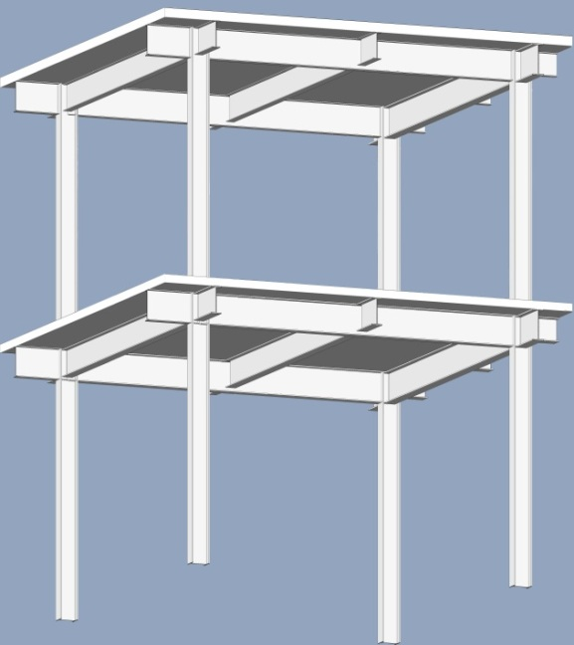
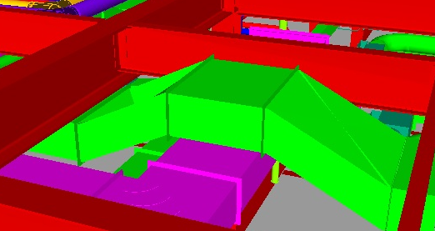
Current Structure
  Efficient Steel Framing
  Beams based on least weight
  Large 11ft deck spans between beams
  Allowable space for MEP
    Routing in between framing

Slide 22
Alternative Floor Systems
  Steel Options
    Girder-slab- inefficient, impractical for this application
    Precast Hollow Core Panel w/ composite beams
  Concrete Options
    One-way Joist and Girder
    Flat plate
    Flat Slab

Slide 23
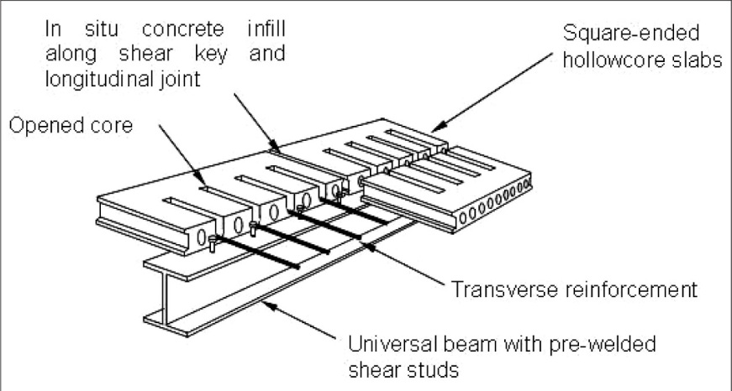
Precast Hollow Core w/Compoite Beams
  Advantages
    Direct Comparison to existing composite beam design.
      6in hollow core slab vs. 6 ¼ in deck+slab
      Composite action - beam and slab
      Flexibility for penetrations
    Possible reductions in beam size
      Larger compression zone
    Schedule and cost reduction potential

Slide 24
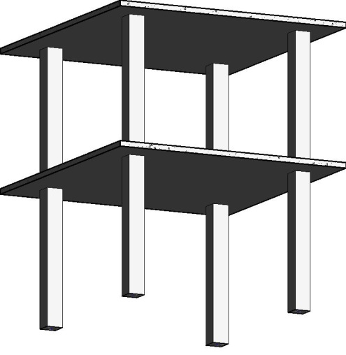
Flat Plate/ Flat Slab
  Advantages
    Monolithic Construction
    Reduced profile
    Slab flexible to penetrations
    One structural plane
    Most flexible for coordination
    Eliminates MEP conflicts
  Design Summary
    8in slab with stud rails
    8in total profile
    24in columns assumed
    11.95 CY concrete per bay
  Flat Slab proven inefficient
    Same 8in slab required
    2.25in drop panels
    13.65 CY per bay
    Extra formwork
    Larger vertical profile

Slide 25
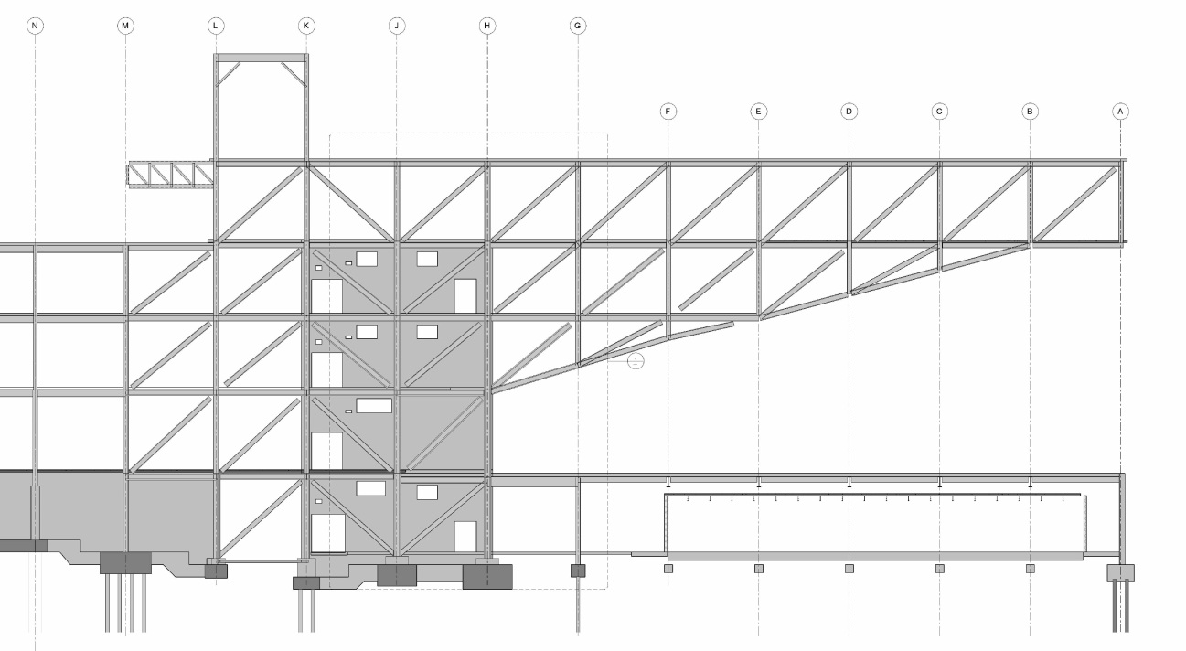
Floor System and Whole Structure
  Floor system connects the elements of entire structure
  Not all typical bays
  Largest integration with cantilever system
    Current steel framing integrated with steel trusses
    Addition of diagonal braces
    Floor system used to distribute loads horizontally
    Design of floor system impacts design of truss system.

Slide 26
Cantilever Truss System
  Floor System will dictate material usage
    One-way joist, flat slab need concrete columns
    Steel framing needs steel columns
  Current Options
    All Steel System- Steel columns, beams, and steel truss
      Metal deck vs. Hollow core floor
    All Concrete System- concrete columns, floor system, concrete cantilever
      One-way joist vs. Flat Plate floor
    Hybrid Systems- concrete and steel where most effective
      All concrete building with steel cantilever system
        Only trusses components are steel
        Floor system formed around truss members
        Large spans in cantilever pose issue for concrete floor systems
      Three building Concept- Two concrete wings and the steel cantilever system

Slide 27
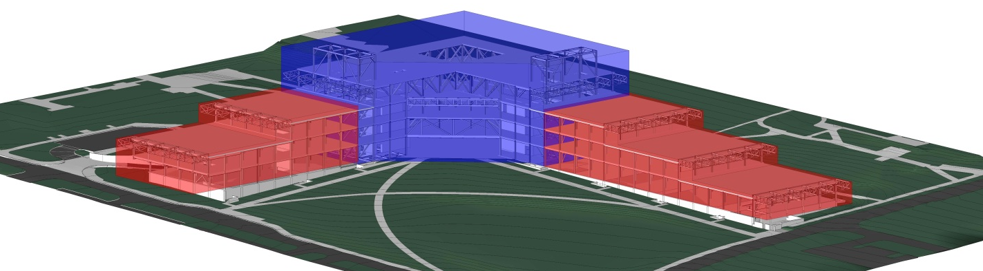
Three Building Concept
  Advantages
    Allows Design of three separate structures
    Individual gravity and lateral systems
    Efficiency of steel Trusses in Cantilever structure
    Coordination benefits of concrete systems .

Slide 28
Structural Solution
  Three Building System- Efficient and Effective
    Concrete construction in wings- focus on integration
      Concrete columns
      One-way joist vs. Flat Plate
    Steel construction in Cantilever- focus on practicality
      Steel columns, beams, girders
      composite beam design
      Metal deck and slab vs. hollow core planks
  (An all concrete and all steel option will be considered as well for unforeseen potential benefits)

Slide 29
Plenum Coordination
Overview
  Plenum space was a large source of additional cost through conflicts and change orders
  A more efficiently designed space could lower conflicts, which would greatly reduce cost of change orders
  Like the façade, changes will have a ripple effect through all disciplines, which will have a corresponding effect on the construction of the building

Slide 30
Steel vs. Concrete
Change in structure provides many changes to construction
  Steel requires fabrication and lead times, but erection is immediate and requires little additional time
  Concrete will not have lead times, but time required for forming, rebar, pouring and curing can be extensive
  Use of concrete can reduce time required for cranes, but will increase labor required for placement
  Cost comparison is undetermined at this point
    Material cost of concrete is lower, but labor will be higher
    Overall benefits to cost and construction can outweigh other problems

Slide 31
Three-Building Approach
Constructing a building of both concrete and steel
Sequencing of trades to eliminate risks to safety and schedule
Logistics of placing steel and concrete
Intersection of the steel and concrete systems

Slide 32
Logistics of Construction

Slide 33
Cost and Schedule Implications
Coordination of ductwork with new structural system
  Reduction of field work due to increased plenum space
  Reduced collisions in field leading to lower costs/less change orders
  Redesigned system to take advantage of additional space
    Higher upfront cost vs. lower lifecycle cost due to reduced energy consumption
Electrical coordination in plenum
  Potential to remove conduit from plenum space
    Reduction of collisions in field leading to lower costs/less change orders

Slide 34
Semester Look Ahead
Lay out BIM Execution Plan
Plan Processes to Achieve Integrated Solutions
Begin to Analyze Design Options
Life Cycle Cost Analyses
System Selection and Evaluation
Questions?

Slide 35
Appendix

Slide 36
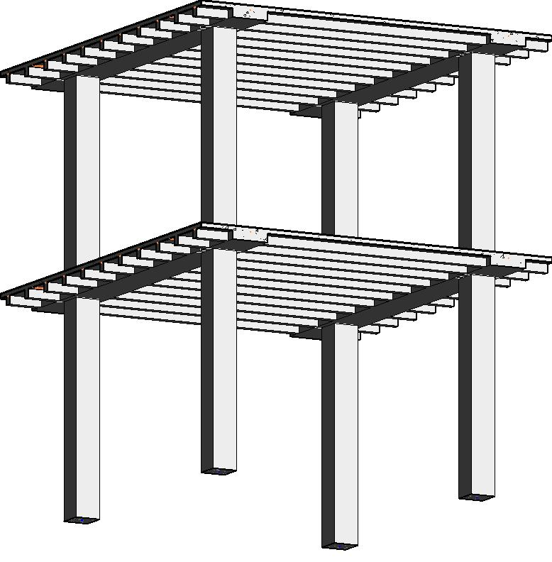
One-Way Joist and Girder
  Advantages
    Monolithic Construction
    Reduced profile
    Slab flexible to penetrations
    Usable space in-between joists
    Girders serve as lateral load collectors
  Design Summary
    4.5in slab
    Joists – 30/6 w/ 8in pans
    36in x 8in girders
    12.5in total profile
    24in columns assumed
    9.00 CY concrete per bay

Slide 37
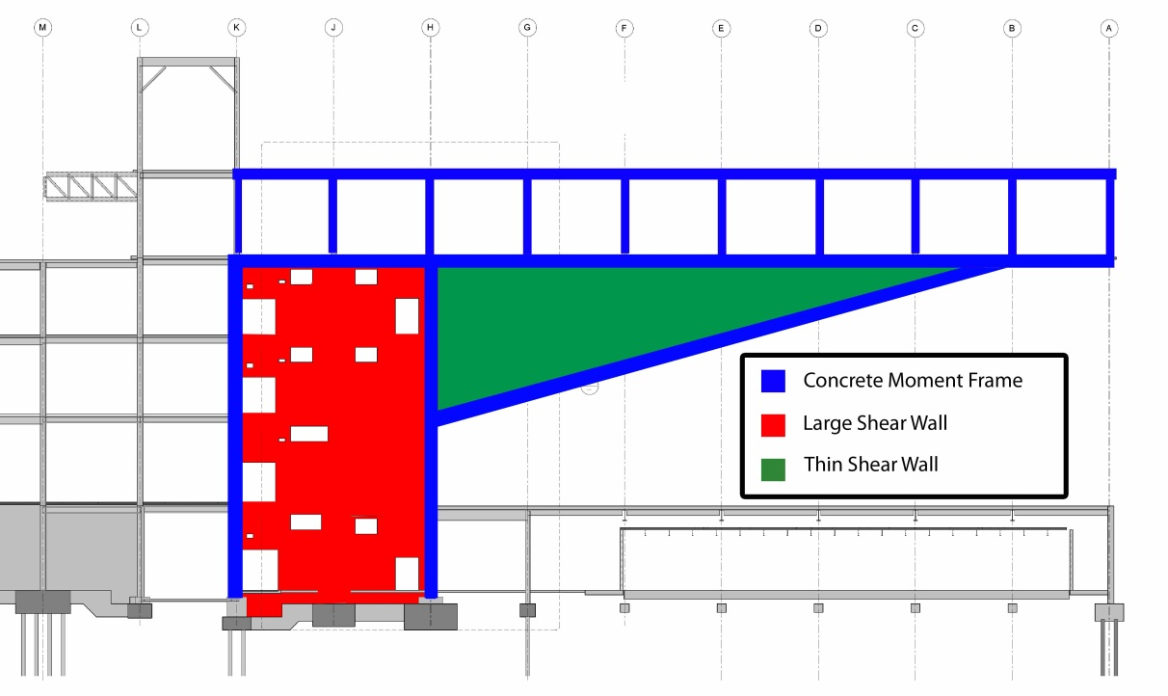
All Concrete Building Option

